Slide 1
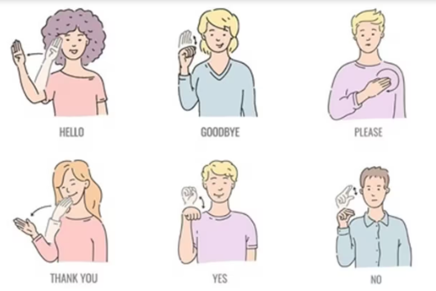
Title: Simple Python-Based Sign Language Translator.
Problem Statement:
To create a basic Python system that can translate sign language gestures (A-Z) into text using computer vision and machine learning.
Algorithm:
Data Collection: Use a dataset of hand gesture images for A-Z.
Image Preprocessing: Resize and normalize images for training.
Model Training: Train a Convolutional Neural Network (CNN) on the gesture dataset.
Real-Time Translation: Capture hand gestures using a webcam and classify them.
Output: Display the translated text on the screen.
Expected Output:
Successful real-time translation of hand gestures (A-Z) into text.
Dataset Authentication:
Validate the dataset using common sign language image sets

